Slide 1
WEB SCRAPING APPLICATION
By Rohini Jadhav

Slide 2
AGENDA
What is Web Scrapping
Why it is required
How it works
Applications of Web Scrapping
My Project Details (Amazon Product Data Extractor)
Notes:
QuickStarter has created an outline to help you get started on your presentation. Some slides include information here in the notes to provide additional topics for you to research.

Slide 3
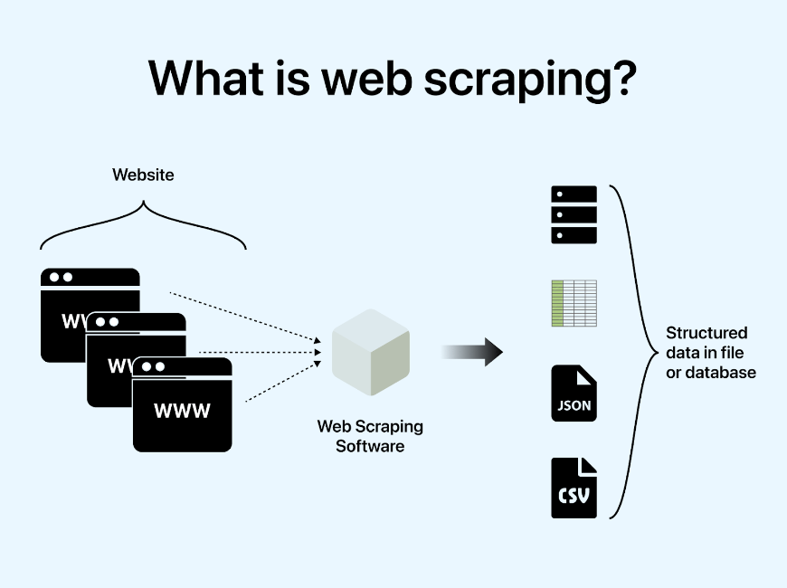
Web Scrapping
WHAT IS IT?
Web scraping is the automatic process of extracting information from a website.
Web scraping technique access the targeted websites through a web browser.
It is a form of copying, in which specific data is gathered and copied from the web, typically into a central local database or spreadsheet, for later retrieval or analysis.
Notes:
QuickStarter has created an outline to help you get started on your presentation. Some slides include information here in the notes to provide additional topics for you to research.

Slide 4
Web Scrapping
WHY?
Access the website and gather the data
It is useful when some website do not have APIs or do not expose APIs for public use and wish to collect data
Web scrapping is not rate limited
Notes:
QuickStarter has created an outline to help you get started on your presentation. Some slides include information here in the notes to provide additional topics for you to research.

Slide 5
Web Scrapping
Web Scrapping
Browser
Access Website
Parse HTML
Locate Element
Fetch the Value
Store Value
HOW IT WORKS?
Access website using http or https
Parse the HTML document
Locate the elements
Fetch/Set the required values
Store the result
Notes:
QuickStarter has created an outline to help you get started on your presentation. Some slides include information here in the notes to provide additional topics for you to research.

Slide 6
Web Scrapping
Applications of Web Scrapping
Job Postings
Extract job posting and internship information
Deal of the Day
Extract offers and discounts
Weather Data
Gather weather data
Price Comparator
Extract product information for comparison
Lead Generation & Marketing
Extract contact details from google maps business listings
Data Analysis
Collect data from multiple websites for analysis purpose
Notes:
QuickStarter has created an outline to help you get started on your presentation. Some slides include information here in the notes to provide additional topics for you to research.

Slide 7
Web Scrapping
Project: Amazon Product Details Extractor using Selenium
Create a new instance of a web driver class
Access the website (amazon.in)
Login to the application by setting username and password
Handle exception explicitly to deal with stale element (try … catch block)
Set the product name in search bar
Extract product information
Window handler to open product specifications page
Notes:
QuickStarter has created an outline to help you get started on your presentation. Some slides include information here in the notes to provide additional topics for you to research.

Slide 8

Web Scrapping
Test Cases
Test Case ID | Description | Pre-conditions | Test Steps | Expected Result
TC_Login_001 | Validate if user can login successfully with provided username and a password | User has a valid Amazon account | Launch the website amazon.in Enter username Enter password Click on Login | Logged in successfully
TC_Login_002 | Validate if user can login with wrong username |  | Launch the website amazon.in Enter username Click Next | Invalid username
TC_Login_003 | Validate if user can login successfully with wrong a password |  | Launch the website amazon.in Enter username Enter password Click on Login | Login Unsuccessful
Notes:
QuickStarter has created an outline to help you get started on your presentation. Some slides include information here in the notes to provide additional topics for you to research.

Slide 9
Web Scrapping
Test Cases
Test Case ID | Description | Pre-conditions | Test Steps | Expected Result
TC_HomePage_001 | Validate home page details post successful login | Login should be successful | Login with valid credentials Verify home page details | Home page should have default product listing, search bar etc.
TC_Search_001 | Check if search text box is allowing to enter the text | Login should be successful | Type the text inside a search box | Should be able to type the product names etc.
TC_Search_002 | Search with a specific available product |  | Enter a valid product name Click on search | Should see the products listing
Notes:
QuickStarter has created an outline to help you get started on your presentation. Some slides include information here in the notes to provide additional topics for you to research.

Slide 10
Web Scrapping
Test Cases
Test Case ID | Description | Pre-conditions | Test Steps | Expected Result
TC_Search_003 | Search with an invalid product | Should be able to enter a text in a search box | Enter an invalid product name Click on search | Products not found message should appear
TC_Search_004 | Check if product listing is clickable | Products should be listed with a provided search criteria | Browse the product list Click on first product from the list | New tab should open
TC_Search_005 | Get the product specifications on a new tab when clicked on product name | Products should be listed with a provided search criteria | Click on the product name Fetch the details from new page | Product details should be seen on the new page
Notes:
QuickStarter has created an outline to help you get started on your presentation. Some slides include information here in the notes to provide additional topics for you to research.

